Slide 1
On the Design and Implementation of a wire-speed Pending Interest Table
Authors: Matteo Varvello, Diego Perino, and Leonardo Linguaglossa
Publisher: NOMEN 2013
(The 2nd IEEE International Workshop on Emerging Design Choices in Name-Oriented Networking)
Presenter: Chia-Yi Chu
Date: 2013/09/11

Slide 2
Outline
Introduction
Name Data Networking
Design Space
Evaluation

Slide 3
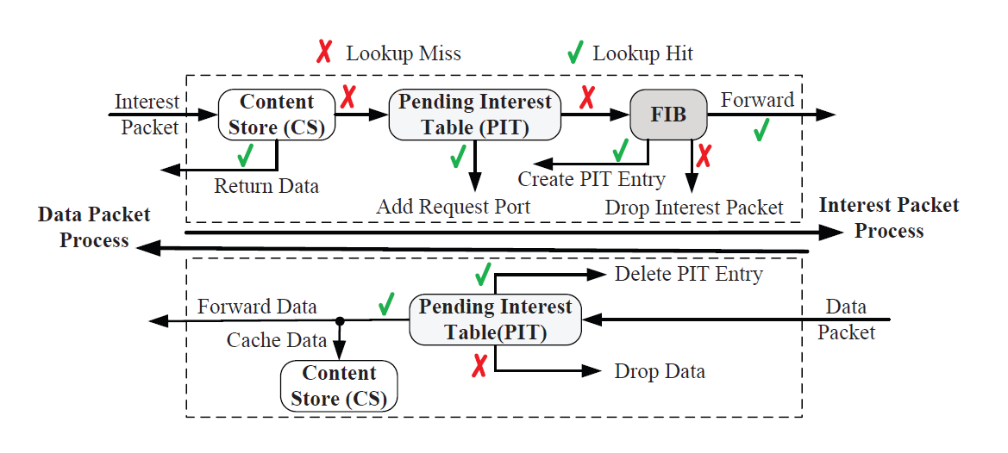
Introduction (1/2)
Information-Centric Networking (ICN) , a novel networking approach where information (or content) replace end-hosts as communication entities.
Named Data Networking (NDN) is one of the most popular ICN designs.

Slide 4
Introduction (2/2)
Pending Interest Table (PIT)
  keeps track of what content is requested and from which line-card’s interface.
  An efficient design of the PIT is thus key to enable NDN (or ICN) at wire speed.
  design consists of two aspects:
    placement
      refers to where in a router the PIT should be implemented
    data structure.
      how PIT entries should be stored and organized to enable efficient operations.

Slide 5
Name Data Networking (1/2)
PIT
  keeps track of the interfaces from where chunks have recently been requested and yet not served.
  tuple <content_name, list_interfaces, list_nonces, expiration>
    content_name
    list_interfaces
    list_nonces
    expiration

Slide 6
Name Data Networking (2/2)
Three operations can be performed on the PIT
  Insert
    when a new Interest is received
  Update
    The new interface is added to list interface
  Delete
    when an entry in the PIT expires
    when a Data is received

Slide 7
Design Space - Requirements (1/6)
Frequent operations
  Assume a wire speed of 40 Gbps, Interest packet with a size of 80 bytes and Data packet with a size of 1,500 bytes.
  A load equal to 100% where no Data is available in response of the Interests
    60 Million operations per second
  flow balance or a load of 50%
    6 Million operations per second.

Slide 8
Design Space - Requirements(2/6)
Deterministic operation time
  Multiple packets are processed in parallel to hide memory access time and increase throughput
  non deterministic operation time would require input queues to buffer packets, causing processes to idle while waiting for others to terminate.

Slide 9
Design Space - Requirements (3/6)
Matching algorithm
  Assume PIT’s lookup is performed using exact matching and not LPM.

Slide 10
Design Space - Requirements (4/6)
Timer support
  PIT’s entries are deleted after a timeout to avoid the PIT’s size to explode over time.

Slide 11
Design Space - Requirements (5/6)
Potential large state
  The PIT size can be estimated as λ*T
    λ refers to the wire speed .
    T is the time each entry lives in the PIT.
  Assume that PIT entries would not last for more than 80 ms.
  PIT would contain no more than about 250,000 entries even when λ = 40 Gbps.
  Worst case: 500 ms. and 1 sec.
  PIT can contain between 30 and 60 Million entries.
Notes:
(40 * 2^30) * (80 * 0.001) = 3435973836.8 (bits)
PIT Entry = 48+ 1 bits
3435973836.8 / 49 = 70,121,915.036
500ms = 21,474,836,480
1s = 42,949,672,960

Slide 12
Design Space - Requirements (6/6)
Distributed design
  each line-card deploys its own PIT.
  Moving from a central PIT to multiple decentralized PITs
    Hard to maintain correct Interest aggregation, loop detection, and multipath support

Slide 13
Design Space - Placement (1/5)
Input-only
  Assume a content router composed by N line-cards interconnected by a switch fabric.
  PIT should be placed at each input line-card.
  Interest creates a PIT entry only in the PIT of the line-card where it is received.
  Data returns at an output line-card, it is broadcasted to all input line-cards where a PIT lookup to check whether the Data should be further forwarded or not

Slide 14
Design Space - Placement (2/5)
Input-only
  enables multipath, but it lacks loop detection and correct Interest aggregation
    each PIT is only aware of local list interfaces and list nonces.
  N PIT lookups in presence of returning Data.

Slide 15
Design Space - Placement (3/5)
Output-only
  PIT should be placed at each output line-card.
  Interest create a PIT entry at the output line-card where it is forwarded.
  limitations in case of multipath
  loops cannot be detected as each output PIT is only aware of the local list nonces.
  requires a FIB lookup per Interest
Notes:
Duplicate PIT in j, k
i to j, k
same Data
i to j
k to l

Slide 16
Design Space - Placement (4/5)
Input-output
  PIT should be placed both in input and output.
  Interest creates a PIT entry both at the input line-card where it is received and at the output line-card where it should be forwarded.
  no unnecessary FIB lookups and duplicated packets in presence of multipath.
  loops cannot be detected.

Slide 17
Design Space - Placement (5/5)
Third party
  PIT should be placed at each input line-card as in the input-only placement.
  selected as j = contentID mod N
    N is the number of line-cards
    contentID is the hash of the content name, or H(A).
  as Data is received, the output line-card identifies j by performing H(A) mod N
  enables both multipath and loop detection
  generates an additional switching operation

Slide 18
Design Space - Data structure (1/4)
Counting Bloom Filter (CBF)
  enables deletion using a counter per bit.
  only stores a footprint of each PIT’s entry
    realizes great compression.
  drawback is false positives that generate wasted Data transmissions.
  Be coupled with the input-only placement
    the compression of its entries loses the information contained in list interfaces.

Slide 19
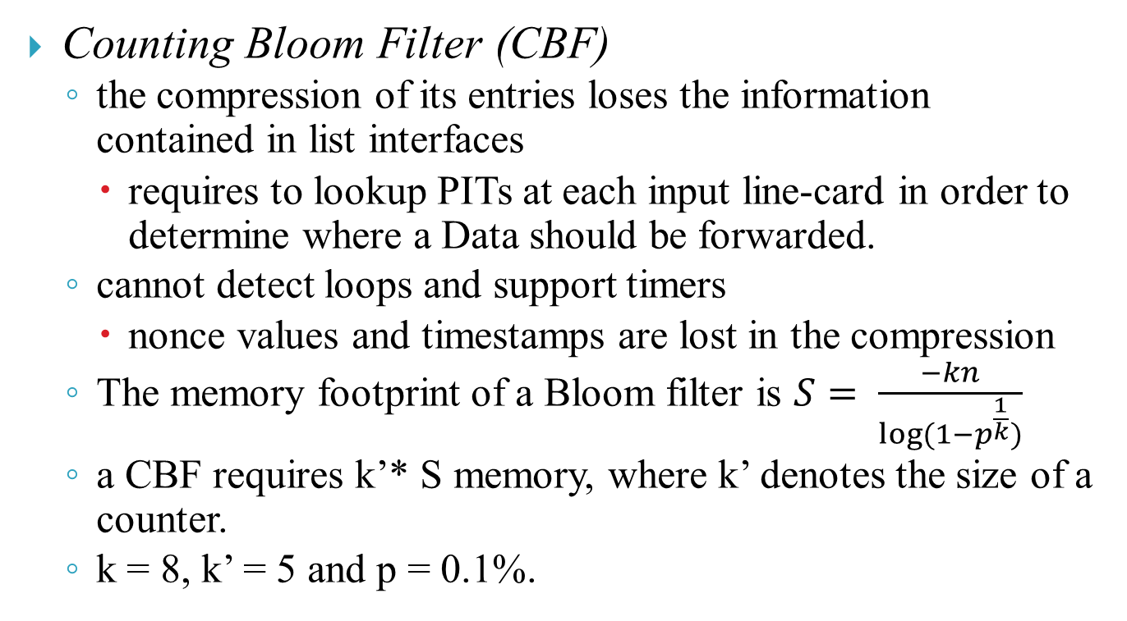
Design Space - Data structure (2/4)
Counting Bloom Filter (CBF)
  the compression of its entries loses the information contained in list interfaces
    requires to lookup PITs at each input line-card in order to determine where a Data should be forwarded.
  cannot detect loops and support timers
    nonce values and timestamps are lost in the compression
  The memory footprint of a Bloom filter is $S= \frac{−kn}{\log{(1−p^{\frac{1}{k}})}}$
  a CBF requires k’* S memory, where k’ denotes the size of a counter.
  k = 8, k’ = 5 and p = 0.1%.

Slide 20
Design Space - Data structure (3/4)
Hash-table
  content name is used as key and its corresponding PIT’s entry is used as a value.
  Be coupled with all placements.
  can detect loop and support timers.
  Need larger memory footprint than CBF

Slide 21
Design Space - Data structure (4/4)
Name prefix trie
  ordered tree used to store/retrieve values associated to “components”, set of characters separated by a delimiter.
  supports LPM, and exact matching as a subset of it.
  Encoded Name Prefix Trie (ENPT)
    reduces the memory footprint of a name prefix trie by encoding each component to a 32-bits integer called “code”.
    drawback is that this compression requires to introduce a hash-table to map codes to components.
    does not specify how to detect loops and remove PIT entries with expired timers.

Slide 22
Evaluation - Numerical (1/5)
Methods
  Assume PIT entry is 48 + 1 bits.
    1(content name) + 16(expiration) + 16(list_nonces) + 16(list_interfaces)
  Linear chaining hash-table (LHT)
    32(CRC) + 32(pointer for chaining) + 48 + 1 = 113 bits.
  Open-addressed d-left hash-table (DHT)
    d = 2
    d sub-tables are accessed sequentially (DHT); parallel (DHTp)
    32(CRC) + 48 + 32(remove content name, use pointer to a table stores content name ) = 112 bits.
  Encoded Name Prefix Trie (ENPT)
    Each component is encoded with 32 bits integer.

Slide 23
Evaluation - Numerical (2/5)
Memory footprint
  To find out which memory should be used for each data structure.
  On-chip memory
    SRAM(4.25 MB, access time of 1ns)
  Off-chip memory
Type | Size (MB) | Access time (ns)
SRAM | 25 | 4
RLDRAM | 250 | 15
DRAM | 10000 - 100000 | 55

Slide 24
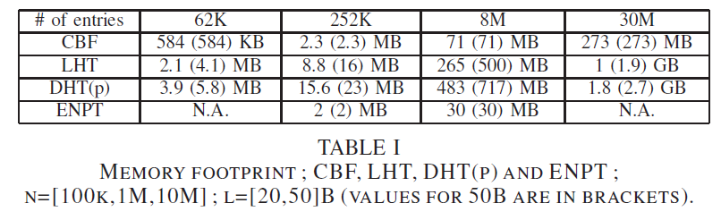
Evaluation - Numerical (3/5)

Slide 25
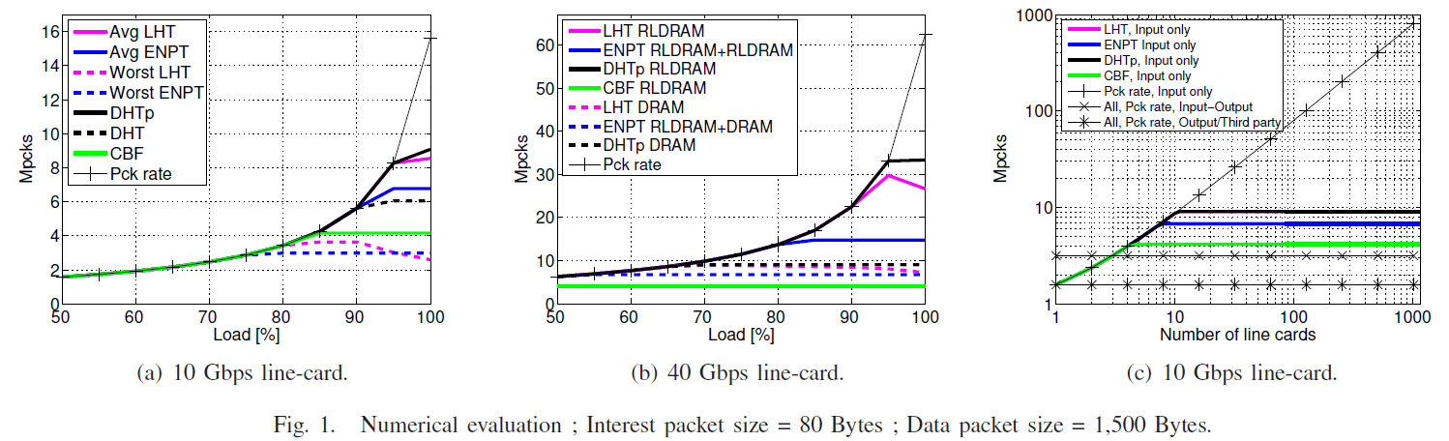
Evaluation - Numerical (4/5)
# of packets each solution can handle as a function of load.

Slide 26
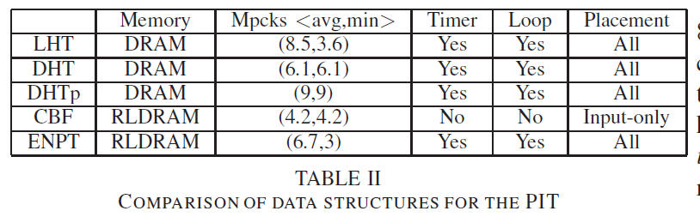
Evaluation - Numerical (5/5)

Slide 27
Evaluation - Implementation (1/2)
DHT-based
  No optimizations
Cavium Octeon Network processor (NP)
  Cavium Octeon Plus CN5650 12 cores 600 MHz network processor equipped with 48KB of L1 cache per core, 2MB of shared memory, 4 GB of off-chip DRAM memory, and an SFP+ 10GbE.
Load = 50 - 80% at 10 Gbps, with a PIT size of 62K and 1M entries.
Interest packets of 80 bytes and Data packets of 1,500 bytes
Short content names (20 bytes)

Slide 28
Evaluation - Implementation (2/2)
3 cores, load=50%
→ 1.5 Mpcks.
8 cores, load = 80%,
→ 3.4 Mpcks.

